Slide 1
INTRODUCTION TO ASP.NET CORE
By: Bhawna Gunwani

Slide 2
ASP.NET Core

Slide 3
Developing Web Application using ASP.NET Core MVC Application

Slide 4
AGENDA
Introduction to ASP.NET Core
ASP.NET Core Folder Structure
Demo: Building a Web Application using ASP.NET Core
Understanding MVC Pattern
Model-View-Controller Communication
Demo: Handling Requests in .NET Core MVC Core

Slide 5
Introduction to ASP.NET Core

Slide 6

INTRODUCTION TO ASP.NET Core
ASP.NET Core is open-source and cross-platform framework.
An unified framework for building web UI and web APIs.
It has built-in dependency injection.
Despite being built on new webstack, it does have high degree of compatibility with ASP.NET.
ASP.NET Core is also perfectly suited for Docker containers.
It has built-In support for SPA with client-side frameworks like Angular, React, Vue.

Slide 7
FEATURES OF ASP.NET Core
Less Code
High Performance
Easy Maintenance
03
02
04
Cloud Based Application Development
Support
Cross-Platform Support
01
05

Slide 8
ASP.NET vs. ASP.NET CORE
Domain | ASP.NET | ASP.NET Core
Platform Support | Asp.Net is Built for Windows | Asp.Net Core runs on Windows, Mac and Linux
Architecture | Based on .NET Framework | Based on .NET Core
Dependencies | Less Control over dependencies | Strict control over dependencies
File Support | WCF, WF, WPF, VB, Web Config, and more | No support for Global.asax, Web config
Components | WebForms, MVC and Web API | MVC, WebAPI, Razor Pages, and Blazor
Visual Studio | Support of all versions | Support of latest versions from 2015

Slide 9
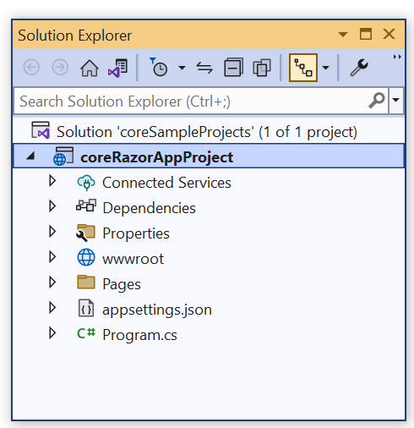
ASP.NET CORE PROJECT FOLDER STRUCTURE
The details of the default project can be seen in the solution explorer.
It displays all the projects related to a single solution.
Project Folder structure is organized in a hierarchical manner.
Each level representing a different aspect of the application.

Slide 10
ASP.NET CORE PROJECT FOLDER STRUCTURE
Here is a brief overview of the different levels and their contents:
Solution Level:
- The highest level is the solution level which represents the entire application.
- The solution level contains solution file, which is used to manage the entire application.
Project Level:
- The project level represents a specific component or module of the application.
- Some common project types include web applications, class libraries, and test projects.

Slide 11
ASP.NET CORE PROJECT FOLDER STRUCTURE
Directory Level:
- Within each project, there are various directories that organize the files and resources.
- For example, “Views” directory contains HTML templates that generate user interface.
File Level:
- At the lowest level of the project structure are individual files.
- These files can include code files, configuration files, asset files (like images) and more.

Slide 12
Building a Basic .NET Core Web Application with ASP.NET Core
DEMO

Slide 13
MVC Pattern

Slide 14
INTRODUCTION TO ASP.NET MVC
ASP.NET MVC is an open-source software from Microsoft.
MVC is a divides an application's implementation into three component roles:
- models, views, and controllers.
It provides an alternative to the ASP.NET Web Forms pattern for building web applications.
ASP.NET MVC has better performance than Web Forms.
It enables developers to create web applications and websites through the use of HTML, CSS,
JavaScript, jQuery besides others.

Slide 15
WEB APP COMPONENTS AND MVC PATTERN
Model Classes
Model
View
Controller
UI Components
Request and Relay

Slide 16
UNDERSTANDING MVC PATTERN
MVC stands for Model, View, and Controller.
MVC separates an application into three components - Model, View, and Controller.
View
Send request
Display
Renders
Controller
Model
Manipulate

Slide 17
MODEL
Model represents the shape of the data.
A Model is a class that represents the data and business logic of the application.
Responsible for defining the data entities, validating input, and performing database operations.
Used in conjunction with data access technologies such as Entity Framework, LINQ or SQ.
Model represents the data

Slide 18
VIEW
View is responsible for rendering the user interface of the application.
View display model data to the user and also enables them to modify them.
A view is typically defined as an HTML template that includes server-side code to render data.
Views can use a variety of technologies to render HTML, including Razor, ASPX, and others.
Client-side technologies such as JavaScript and CSS can be used to enhance the user interface.
View represents the User Interface

Slide 19
CONTROLLER
A controller is responsible for handling user input and updating the model and the view.
It is the component that handles requests from the client,
Performs necessary operations on the model, and selects the right view to render the response.
Controller is defined as a class that inherits from the base controller class in ASP.NET MVC.
Includes action methods that correspond to user requests and perform operations on the model.
Controller represents the request handler

Slide 20
Model-View-Controller Communication

Slide 21
MODEL-VIEW-CONTROLLER COMMUNICATION
BROWSER
OUTPUT
Request
Response
CONTROLLER
Rendering the Data
Exchange Data
VIEW
MODEL

Slide 22
MODEL-VIEW-CONTROLLER COMMUNICATION
Model to Model:
We can communicate from Model to Model via parameters/composition.
Model to View:
To communicate Model to View, you have to follow the path: Model > Controller > View.
We can’t directly move from Model to View.
First, the Model object is made in the Controller and then it is passed to View.
We can pass the data or communicate from Model to View by these three steps:
- Take the object in the action of a Controller.
- Pass Model object as a parameter to View.
- Use @model to include Model on the View page.

Slide 23
MODEL-VIEW-CONTROLLER COMMUNICATION
Model to Controller:
Create an object of Model class in Controller to access the Model in Controller.
View to Model:
To communicate View to Model, you have to follow the path: View > Controller > Model.
We can’t directly move from View to Model.
First, you have to submit data to the controller and then pass it to the model.
To pass the data from View to Model, you have to follow these three steps:
- Submit HTML form to a Controller.
- Create an object of Model in Controller.
- Pass Values to the Model object.

Slide 24
MODEL-VIEW-CONTROLLER COMMUNICATION
View to View:
We can move from one view to another view by using partial views.
View to Controller:
We can move data from view to controller by submitting forms to controllers or by:
- JSON
- AJAX Calls
- JavaScript
- Partial Views

Slide 25
MODEL-VIEW-CONTROLLER COMMUNICATION
Controller to Model:
We can move from Controller to Model just like we move from Model to Controller.
View to Controller:
We can move data from controller to view in the following ways:
- By using viewBag
- ViewData
- TempData
Controller to Controller:
We can move from one Controller to another by using RedirectToAction();
and then pass the name of the specific action.

Slide 26
Handling Requests in .NET Core MVC Core
DEMO

Slide 27

Thank You

